Slide 1
UAS Operations – Law, Safety & Data Protection
Roy Amos BScEcon(Hons.) PgDipLaw PgDipSurv MCIArb
Managing Director, Panodrone
Qualified UAV Pilot, BSI & ISO committee member (UAS standards), Chartered Arbitrator, Quantity Surveyor
Notes:
Thank you for the introduction
Good morning and welcome to you all

Slide 2
Content
Legal
UK law and regulation governing Unmanned Aircraft Systems (UAS)
Due diligence / compliance checks
Legal operating constraints / limits
Safety
Key safety considerations when operating UAS
Privacy & Data Protection
Aerial data collection - risks to privacy & data protection
Tips for managing aerial data collection using UAS
Notes:
Must mention scope of presentation:
UK focussed
Commercial operations, not hobbyist
Mention EASA proposals – change to regulatory framework – may be adopted by UK (regardless of Brexit)
This presentation will focus on current regulations and legislation
It won’t be exhaustive, but will give a good overview of the subject matter
Why……is regulation needed? What purpose does it serve?
Who?.........Who governs and manages the regulatory framework in the UK? Who is captured in its scope?
What? What are the key pieces of legislation and regulation which we need to be aware of?

Slide 3
Legal
Why regulate unmanned aircraft?
SAFETY - Protect air users and non-air users alike
Aim to reduce risk of:-
Conflict in the air (particularly with manned aircraft)
Collisions on the ground
Notes:
Reduce conflict: Air risks – collisions with manned aircraft of other UAS), Ground risks (collisions with persons and property on the ground)
Operating constraints – distances: people and property on the ground and airports etc, heights for airspace separation from manned aircraft

Slide 4
Legal
Who is responsible?
UK Civil Aviation Authority – National Aviation Authority
Created under Civil Aviation Acts - authority from UK parliament
Hold variety of statutory duties – focus on civil aviation safety
Governs manned and unmanned aviation
European governance & regulation: EASA
Notes:
EASA: Open, specific catergories

Slide 5
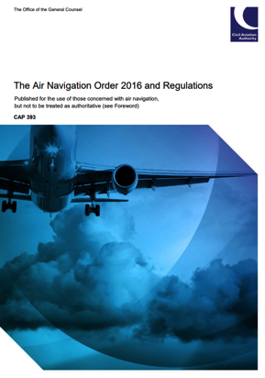
Legal
What regulation exists?
UK has well-established regulatory framework for unmanned aircraft
CAP 393: Air Navigation Order 2016 (UK legislation)
CAP 722: Unmanned Aircraft Systems Operation in UK Airspace (Guidance)
Notes:
Articles 241, 94 & 95

Slide 6
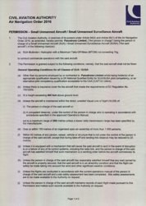
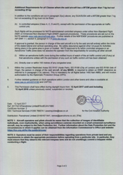
Legal
Due diligence on operators
Pilot qualification (NQE)
PfCO or Permission for Commercial Operations (aircraft mass, type)
Operating within currently granted permissions
Insurance (compliant with EU Regulation (EC) 785/2004)
Operations manual
Flight logs / pilot logs
Site safety assessment / RAMS
Any other permissions e.g. industry specific, operating in restricted areas
EG R158
EG R157
EG R 159
Notes:
Mention that exemptions for pilot qualification may apply, for example qualified pilots of manned aircraft.

Slide 7
Legal
Operating under a Standard PfCO
Max. height: 400ft / 122m
Distance: VLOS or 500m
Congested areas: 7kg or less – OK,
Over 7kg – No fly
Proximities: to persons, vessels, vehicles,
structures
7kg or under = 50m
>7k - <20kg = 150m
unless under the control of the pilot
Flying overhead: Not permitted (Para. 3.27 CAP 722)
Article 241: Endangering safety of any person or property
ALWAYS PREVAILS!
Notes:
Clarify system mass meaning – MTOM or Maximum take-off mass (everything including fuel (battery) and payload)

Slide 8
Legal
Exemptions / adjustments against standard PfCO
Distances to persons, property, vehicles & vessels
EVLOS
BVLOS
Night operations
Can be sought via application to the CAA……..
….subject to demonstrating a robust safety case
Notes:
Clarify system mass meaning – MTOM or Maximum take-off mass (everything including fuel (battery) and payload)

Slide 9
Safety
Safety focus – protect……
People on the ground
People in the air
UAS pilot and crew
Property / assets / infrastructure (whether on the ground or in the air)
…………How do we achieve this?
Notes:
Clarify system mass meaning – MTOM or Maximum take-off mass (everything including fuel (battery) and payload)
Direct harm - impact / collision of UAS, UAS fire, other injury caused by UAS directly
Consequential harm – Secondary fires / explosions, secondary collisions

Slide 10
Safety
Human Resources (Pilot and crew)
Health and fitness
Competence and experience
Appropriately trained and qualified
Experience – System, environment, task
Sufficient numbers of suitably qualified and experienced personnel to complete task safely
Appropriately equipped – PPE, clothing, footwear

Slide 11
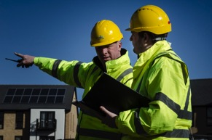
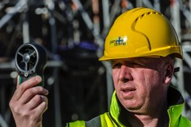
Safety
Operating Procedures
Robust plan / method to complete the task safely
Risk assessed and risk mitigated to acceptable levels
Pilot satisfied flight can safely be made
Residual risk: Back-up / emergency / contingency plans
All Permissions in place / liaison with authorities / notices given
Environmental conditions safe to operate in / within aircraft and pilot / crew tolerances

Slide 12
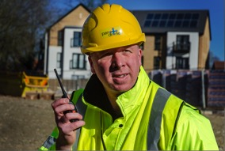
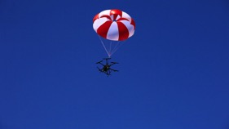
Safety
Equipment
Appropriate UAS: for the task, environmental conditions
System properly maintained & fully serviceable
Safety & communications
equipment

Slide 13
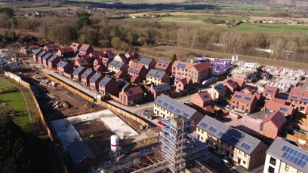
Privacy & Data Protection
Advantages
Unique perspective
Improved quality / resolution of data
Volume of data
Challenges
Greater risk of:
privacy impact (perspective from height, location)
Collection of personal data (resolution, volume)
More data to store, manage, transfer

Slide 14
Privacy & Data Protection
Solutions
Privacy Impact Assessments
Notify / seek permissions
Minimise unintended data collection
Time of flights
Height
Control data collection (stop / start)
Sensor configuration e.g. lens and FOV
Establish secure processes for data management, storage, transfer
Anonymise data
Dispose of data
…...For more information visit the Information Commissioners Office

Slide 15
Questions & Answers

